Slide 1
MUSHROOMS: TO EAT or NOT TO EAT
Utilyzing Data Analysis and Machine Learning to
classify a mushroom as Edible or Poisonous

Slide 2
The “Why”, “What” and “How”
WHY: Ideas discussed:
Local real estate behaviors
Healthcare ideas
Recipe collections
Plants (which factored into the final idea: mushrooms)
Data accessibility was a primary factor in determining this topic.
In the end, the underlying motivation for all of these ideas was to provide a tool to promote community and social wellness.

Slide 3
The “Why”, “What” and “How”
WHAT:
Edibility is defined as “the absence of poisons and the presence of a desirable taste and smell”.
Health benefits of consuming mushrooms: low in sodium, fat & calories; contain: Fiber, Potassium, Protein, Selenium (antioxidant), Copper (for cardiovascular health), Niacin (important Vitamin B), cancer-fighting ingredients (polysaccharides, linoleic acid), and Zinc.
Above from: https://www.mushroom-appreciation.com/edible-mushrooms.html

Slide 4
The “Why”, “What” and “How”
HOW: Data from the Audubon Society was analyzed and machine learning applied to predict if a mushroom was edible or poisonous.
Every mushroom in this data set is classified as either poisonous or edible and includes 22 features. There were two data set files:
Primary: The primary data set encodes the textbook mushroom entries which includes 173 mushroom species.
Secondary: The secondary data set is the pilot data which includes the results of simulations.

Slide 5
The Questions to be Answered
QUESTION 1: What features of a mushroom are best suited for this prediction?
QUESTION 2: If given the features of a mushroom, can we confidently predict whether or not that mushroom is poisonous?

Slide 6
Data Analysis Phase of the Mushroom Project
We planned out multiple machine learning approaches (detailed in the machine learning slides) and created a correlation plot to see which data was correlated with the variable we wanted to predict.

Slide 7
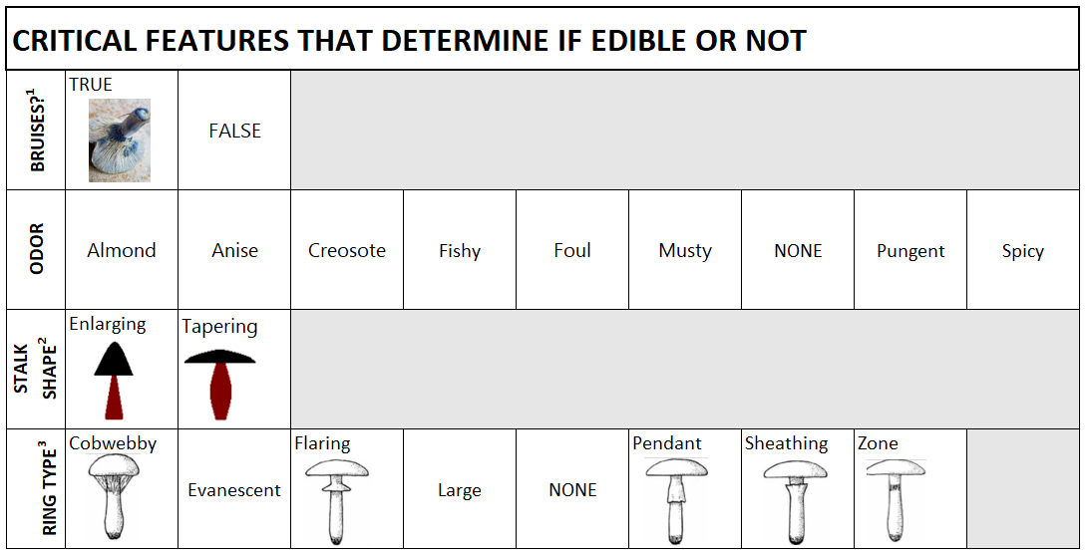
Mushroom Features in the Model
¹ https://bit.ly/3s41u0d
² https://bit.ly/3s3Lmvq
³ https://binged.it/3KwH8TG

Slide 8
Technologies, Languages, Tools, and Algorithms used in the Mushroom Project
SQL database (local: postgres.sql)
Python (VS Code / Juypter Notebook)
Website (FLASK)

Slide 9
Machine Learning Model: A. Description of Data Pre-Processing
Eliminated all null values from the primary and secondary dataset, including "?" representing nulls in the dataset.
Renamed the columns to match between both the primary and secondary datasets so they could be merged.
Dropped columns that were not contained in both datasets to create a full combined dataframe.

Slide 10
B. Preliminary feature engineering & selection (including decision-making process)
In order to decide which feature to use for the input of the machine learning model, we took multiple approaches and compared the results of each output:
RandomForest
TensorFlow
Correlation Analysis
XG_Boost
After comparing the results of each, we concluded that XG_Boost was the most reliable machine learning model to use. We will ask the user to input variables that are highly correlated to whether or not a mushroom is poisonous for prediction.

Slide 11
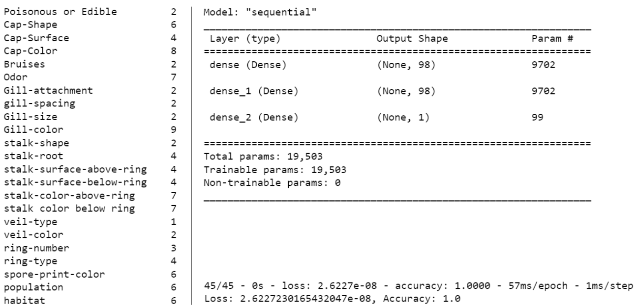
TENSOR FLOW RESULTS

Slide 12
C. How Data was Split into Training and Testing Sets
Used skelearn.model_selection function train_test_split to train, test, and split the data based on whether or not the mushroom was poisonous or not.

Slide 13
D. Model Ultimately Chosen, Including Limitations and Benefits
We chose to continue using XG_Boost:
Advantages:
Regularization for avoid overfitting
In-built cross-validation capability
Cache awareness and out-of-core computing
Tree pruning using depth-first approaches

Slide 14
D. Model Ultimately Chosen, Including Limitations and Benefits (continued)
In using XG_Boost, these are disadvantages:
Disadvantages:
Sensitive to outliers
Susceptible to overfitting
Black-Box Nature is not always straightforward in explaining what is happening in the background

Slide 15
E. How the Model was Trained
OneHotEncoder was used together with train.test.split from sklearn.
No additional training will take place

Slide 16
F. Current Accuracy Score
The accuracy score is 1.0.
This is most likely due to the data being academic and created specifically for the machine learning purposes.

Slide 17
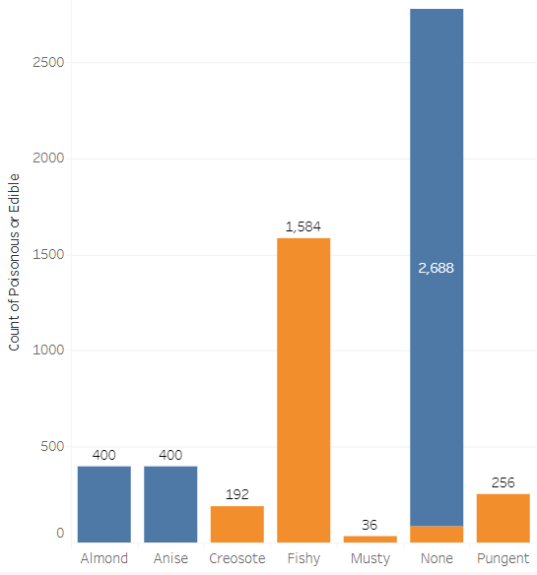
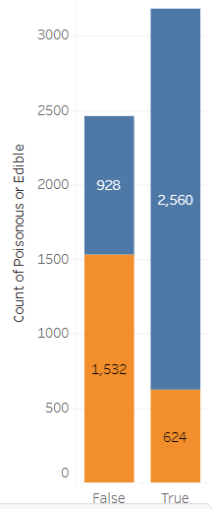
DASHBOARD: Distributions on Top 4 Features
BRUISES
ODOR

Slide 18
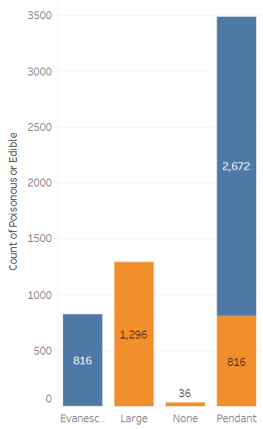
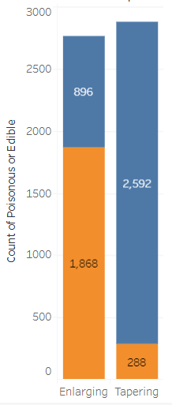
DASHBOARD: Distributions on Top 4 Features (continued)
STALK SHAPE
RING TYPE

Slide 19
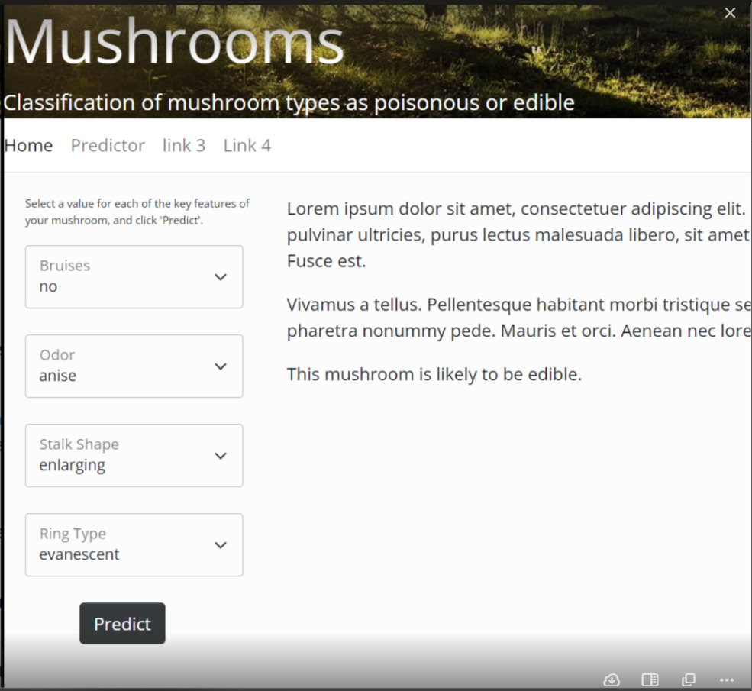
WEBSITE

Slide 20
We Hope This Helps You and Your Family
The American Association of Poison Control Centers reported that in 2019, there were 5,799 mushroom poisonings, including 2 deaths. Many of those cases were likely due to accidental ingestion of a mushroom that was thought to be edible.

Slide 21
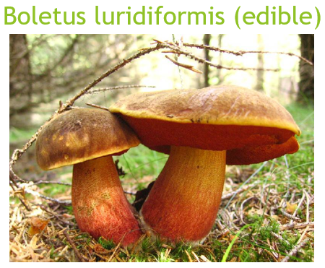
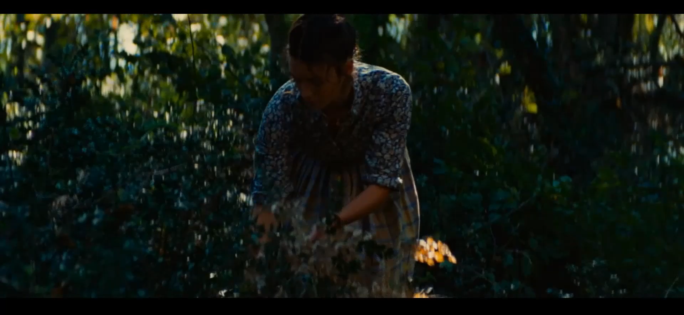
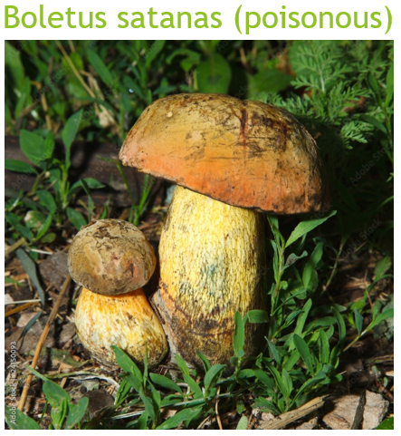
The “Why” example: look the same
From: “The Hundred-Foot Journey”

Slide 22
Edits to be made
INSERT Dashboard and Plotly Graphs
INSERT LAST SLIDE: with video with captioning

